Slide 1

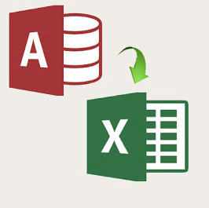
DEVELOPMENT OF AUTOMATIC MILK COLLECTION & BILL GENERATION SOFTWARE
BTP Final Review,
Department of Computer Science & Engineering, IIT Jodhpur
HARSHIT SINGH (B15CS019)
ANKIT KUMAR (B15CS008)
Project Mentor- Dr. Chiranjoy Chattopadhyay,
Assistant Professor,
Dept. of Computer Science and Engineering,
IIT Jodhpur

Slide 2
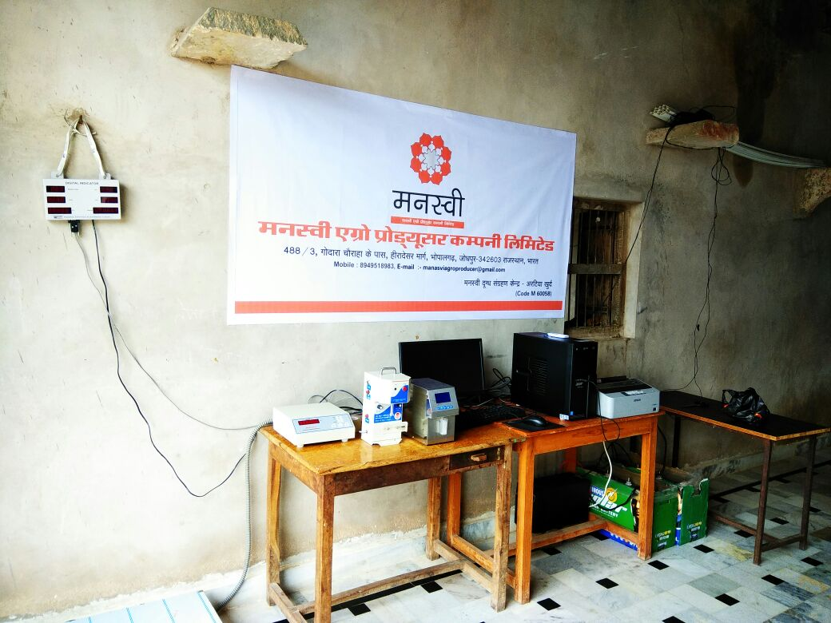
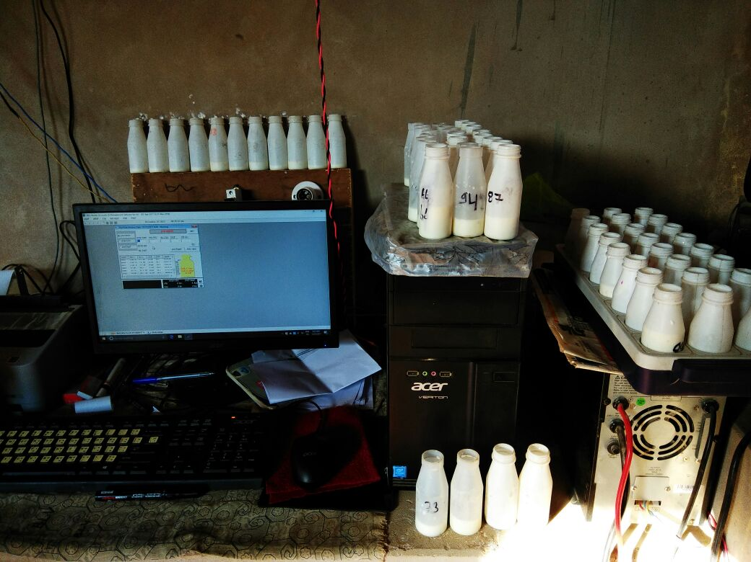
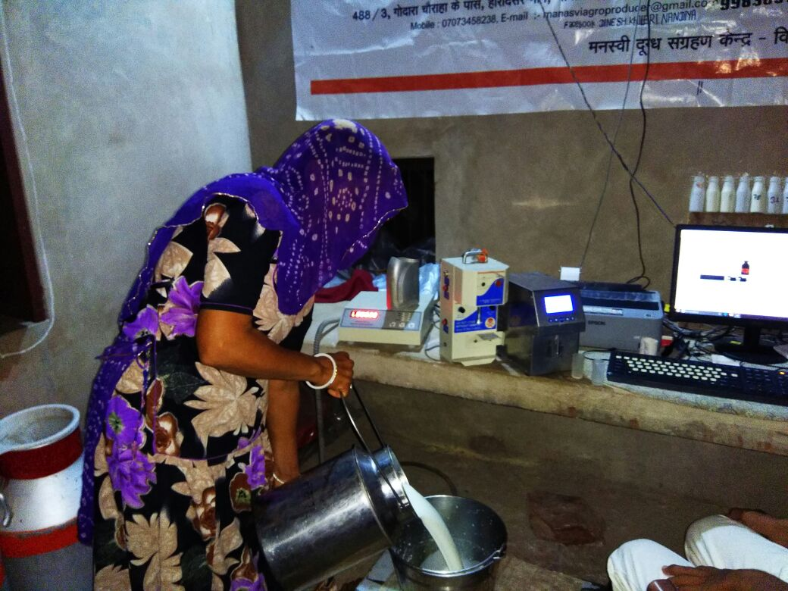
Actual Scenario at the Milk Collection Center at Bhopalgarh Manasvi run by ICICI RSETI
Presently the conversion is being done online
The process to generate the proper billing sheet after obtaining the csv file online takes at least 2 days for a single center (and presently they have 6 of them)
The end users have very little or no knowledge of using the computers and so they want a software which can process at a single click

Slide 3
PROBLEM STATEMENT
Extracting a particular table from the “Reilsams.mdb” database file obtained from the collection center in Offline mode
Automatic customization of the extracted table in the desired layout
Removing unnecessary and insignificant data
Adding the extra fields
Generation of sheet in different modes
According to Date
By Payment Cycle
Develop a user friendly GUI

Slide 4
BLOCK DIAGRAM
Process
Output
Extract table from database and convert to csv file
Modify the csv to a desired format
Add Extra Fields using member code to names
Develop a GUI for interaction
Date wise separated Required automatically generated Billing Sheet in the required format with added fields as xlsx file
Input
Reilsms.mdb file
Mode of Usage
Member Code with Names
Date Range (if required)

Slide 5
IMPLEMENTATION
The software has been developed using python
Libraries used :-
tkinter to develop GUI
pypyodbc to establish connection with the database
csv for operations on csv file
openpyxl for operation on the excel file
xlrd for reading from the excel sheet
Windows Installer for distribution and direct installation of software which enables the user to run the application with the need of terminal and python
Dynamic path implemented using configuration file
Abstraction :- The key component of implementation is the level of abstraction used as every intermediate step or background processes are hidden from the user
Scalability :- The Software supports addition of any number of centers and any number of members
Testing and Exception Handling has been done extensively in accordance with the GUI

Slide 6
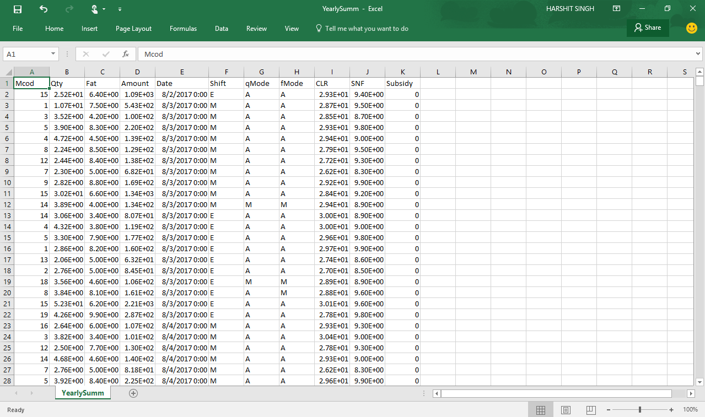

Slide 7
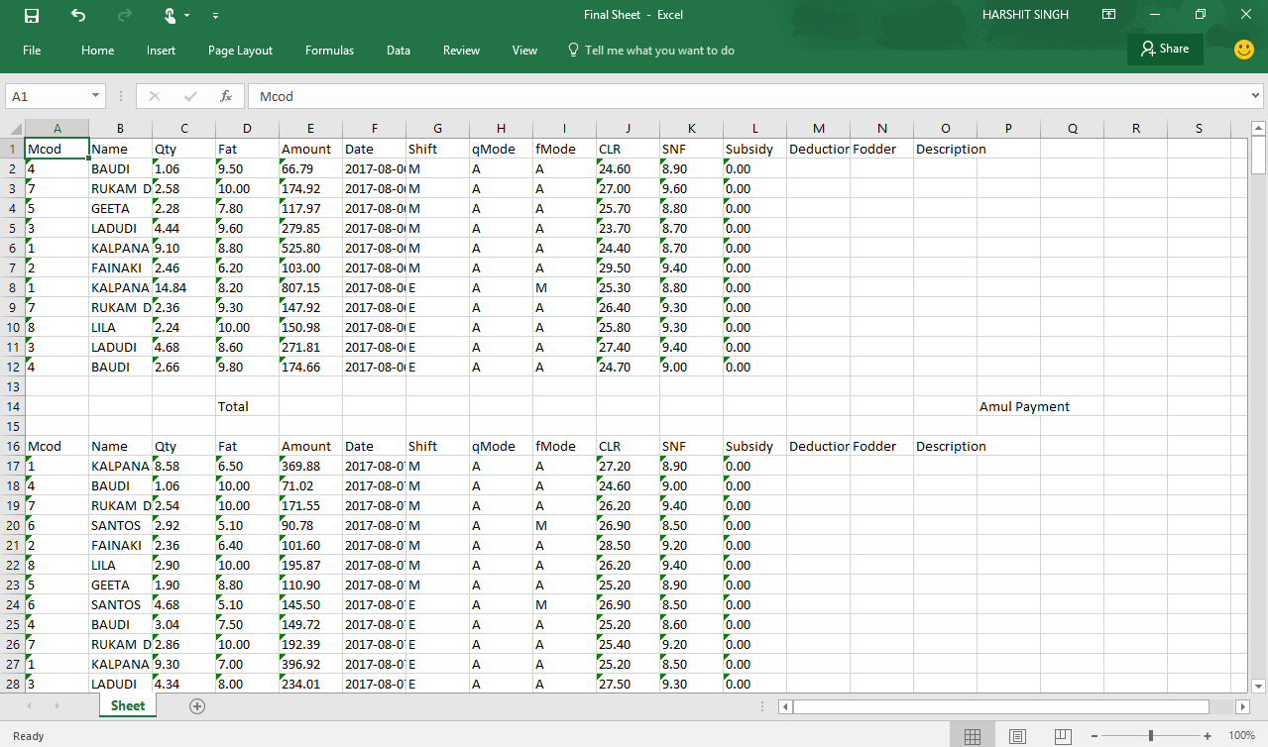
These are newly added automatically generated fields
Bill sheet has been given the proper data separated for each day

Slide 8
Thank you

